Slide 1
WATER QUALITY PREDICTION
Done By :
20B01A12C3
Venkata Naga Divya Nallavula

Slide 2
Problem Statement :
In this WATER QUALITY PREDICTION PROJECT ,we are going to develop an online-based system to analyze the quality of water(safe or unsafe).
In this technique , our model predicts whether the water is safe to drink or not . By using some parameters like ph value, conductivity ,hardness ,etc.

Slide 3
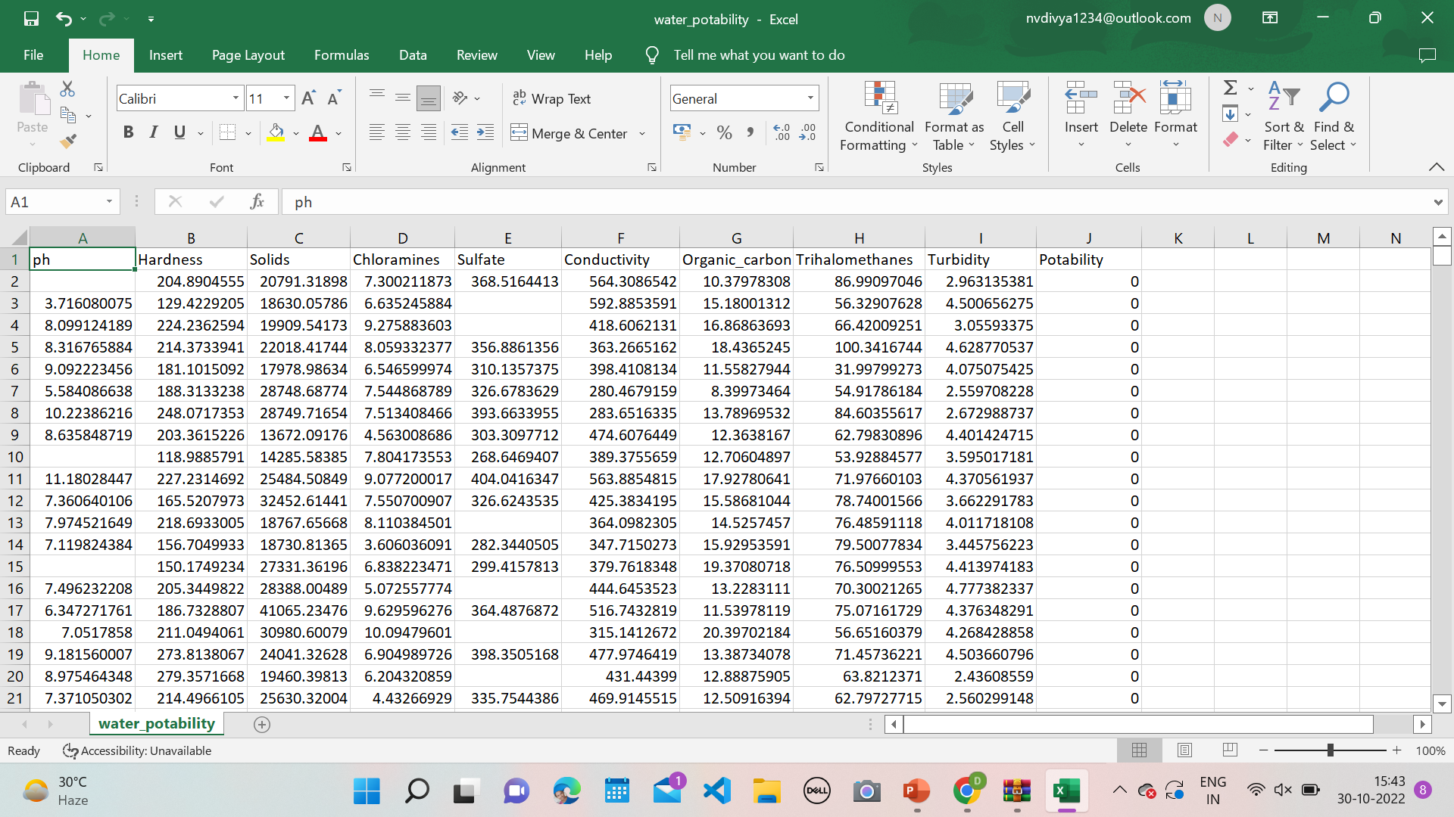
DATA SET :
In this project we are considering a dataset which consists of more than 3000 plus water samples and there respective parameters that are required for prediction .

Slide 4
Attributes of the dataset and their optimal range :
ph – Neutral range(6-7)
Hardness – low range Solids – 500 to 1000 mg/l
Chloramines – low range (<4 mg/l)
Sulfate – low range(<250 mg/l)
Conductivity – very less (insulator)
Organic_carbon – low(<2 mg/l)
Trihalomethanes – low (<80 ppm)
Turbidity – 5 to10 ppm
Potability – 1(safe)

Slide 5
PRE-PROCESSING:
Data preprocessing is an essential task for cleaning the data and making it suitable for machine learning model which increases the accuracy and efficiency of the model
In Dataset some of the columns like ph, sulphate, Trihalomethanes contains some missing values.
We can handle these missing values by filling it with mean value of the each feature.

Slide 6
ALOGRITHM :
Logistic Regression
Logistic regression predicts the output of a categorical dependent variable. Therefore the outcome must be a categorical or discrete value.
It can be either Yes or No, 0 or 1, true or False, etc. but instead of giving the exact value as 0 and 1, it gives the probabilistic values which lie between 0 and 1.

Slide 7
THANK YOU

